Slide 1
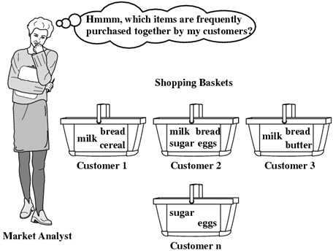
4. Data Mining Techniques :Association rule mining
Association Rule Mining:
Basic idea: item sets, Frequent Item-sets
Association Rule Mining
Generating item sets and rules efficiently

Slide 2
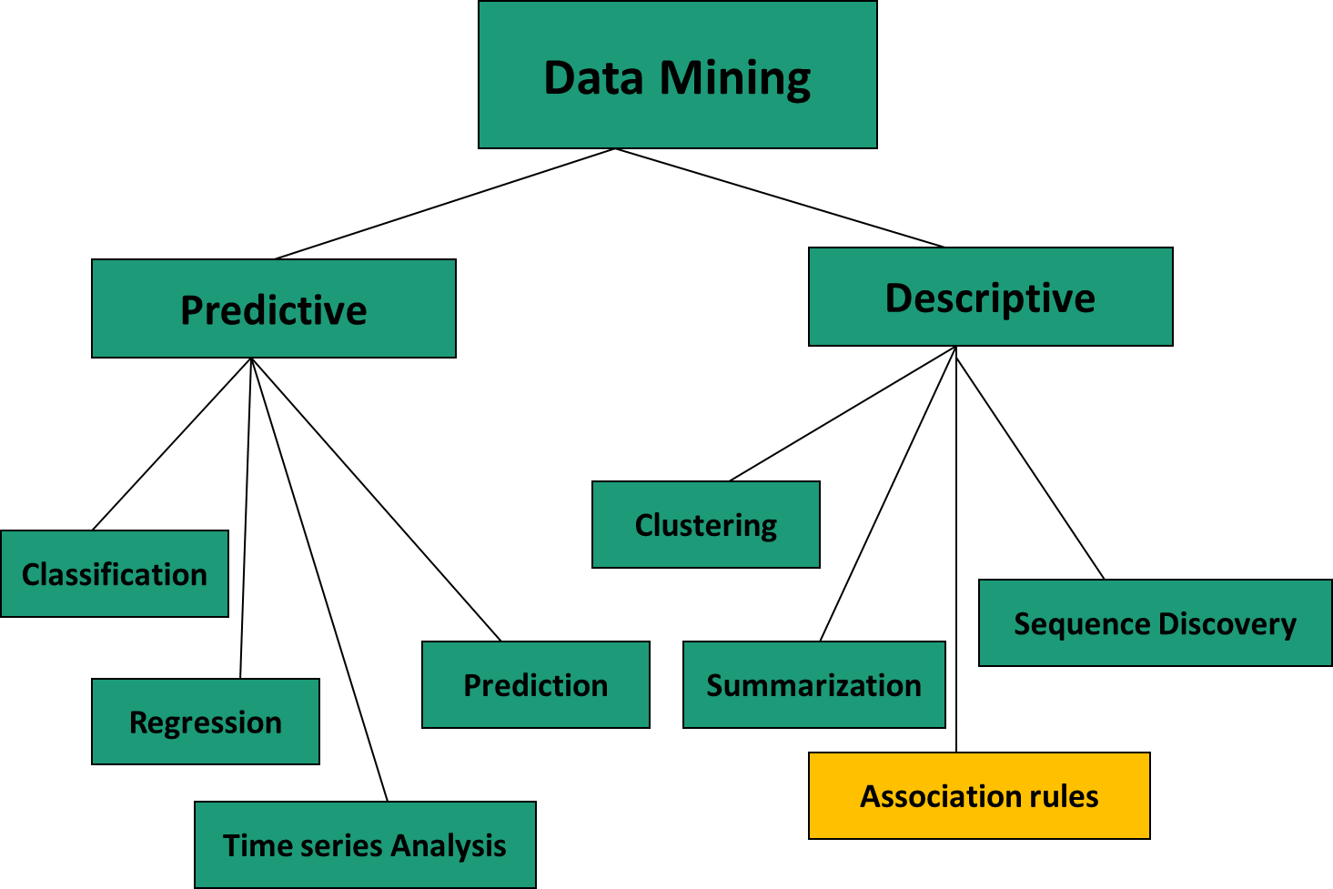
Data Mining Techniques

Slide 3
Association rule mining
Data mining is the process of extracting interesting, non-trivial, implicit, previously unknown and potentially useful patterns or knowledge from huge amount of data
Association rule mining is one of the data mining techniques used for discovering interesting relations between variables in large databases.

Slide 4
Frequent Pattern mining
Frequent pattern mining searches for recurring relationships in a given data set.
Frequent itemset mining leads to the discovery of associations and correlations among items in large transactional or relational data sets.
With massive amounts of data continuously being collected and stored, many industries are becoming interested in mining such patterns from their databases.
The discovery of interesting correlation relationships among huge amounts of business transaction records can help in many business decision-making processes such as catalog design, cross-marketing, and customer shopping behavior analysis.
A typical example of frequent itemset mining is market basket analysis.

Slide 5
Market basket Analysis

Slide 6
Broad set of Application Areas
Mining relationship between attributes in databases
Mining associations between proteins in BioInformatics
Mining Association between drugs or diseases in Medicine
Mining Association between program elements in Code analysis

Slide 7
Broad set of Application Areas
Mining relationship between attributes in databases
Mining associations between proteins in BioInformatics
Mining Association between drugs or diseases in Medicine
Mining Association between program elements in Code analysis

Slide 8
Association rule
An Association rule is an implication of the form X ⇒ Y , where X and Y are subsets of an attribute set and X∩Y = Φ .
X is often referred as the antecedent and Y as the respondent.
In case of Market transaction, when item X is purchased by customer then item Y is also purchased.
Bread => Butter indicates that these two items are often purchased together.
Measures support and confidence are used to confirm interestingness of discovered association rule.

Slide 9
Itemset
An itemset X is a subset of set of items in the data base
Ex. Supermarket database contains m items I={i₁,i₂,..,i_{m}}
superMarket ={ Bread, Cheese, Butter, Jam, Milk, Tea, Coffee, Juice, Sugar}
Every purchase transaction will then contain a subset of these set of m items.
Transaction Id | Items Set | Boolean Vector
TA | {Bread, Butter, Juice} | {101000010}
TB | {Bread, Butter, Tea, Coffee} | {101001100}
An itemset X is a subset of set of items in the data base.
{Bread, Butter, Juice} ⊆ { Bread, Cheese, Butter, Jam, Milk, Tea, Coffee, Juice, Sugar}

Slide 10
Itemset
An itemset X is a subset of set of items in the data base
Ex. Supermarket database contains m items I={i₁,i₂,..,i_{m}}
superMarket ={ Bread, Cheese, Butter, Jam, Milk, Tea, Coffee, Juice, Sugar}
Every purchase transaction will then contain a subset of these set of m items.
Transaction Id | Items Set | Boolean Vector
TA | {Bread, Butter, Juice} | {101000010}
TB | {Bread, Butter, Tea, Coffee}
An itemset X is a subset of set of items in the data base.
{Bread, Butter, Juice} ⊆ { Bread, Cheese, Butter, Jam, Milk, Tea, Coffee, Juice, Sugar}
A k-itemset contains k items.
{Bread, Butter, Juice} is 3-itemset , {Bread, Butter, Tea, Coffee} is 4-itemset

Slide 11
Association rule measure :Support Count
The support count of an itemset is the number of transactions in which that itemset occurs
The support count of an association rule X => Y is the support count of itemset XUY
Support count is absolute support
Example
Transaction Id | Items bought
TA | Bread, Butter, Juice 1
TB | Bread, Butter, Tea, Coffee 0
TC | Bread, Jam, Juice 2
TD | Tea, Coffee, Sugar 0
TE | Bread, Butter, Sugar 0
1. Support Count({Bread,juice})=2
2. Support count({Tea,cofee})= ?
3. Support count ({Bread,Butter})=?
4. Support count ({Bread=>Butter})= ?
5. Support count({Bread,Butter})=>tea = ?

Slide 12
Association rule measure :Support
Support(relative support) of an itemset X is defined as follows
Support(X)= (support count of X) /N
Support(X => Y) = (support count of XUY) /N
Where N is total number of transactions.
A high level of support indicates that the rule is interesting enough to be taken note of.
Support ({Bread,juice})= (support count of {Bread,Joiuce}) /N
= 2/5
2. Support ({Tea,cofee})= ?
3. Support ({Bread,Butter})=?
4 Support ({Bread=>Butter})= ?
5. Support ({Bread,Butter}=>tea) = ?
Transaction Id | Items bought
TA | Bread, Butter, Juice
TB | Bread, Butter, Tea, Coffee
TC | Bread, Jam, Juice
TD | Tea, Coffee, Sugar
TE | Bread, Butter, Sugar

Slide 13
Association rule measure :Confidence
Confidence of a rule (X => Y) is defined as follows
Confidence ( X => Y) = P(Y|X)=support of( X U Y) /support of (X)
Where N is total number of transactions.
A high level of confidence indicates usefulness of the rule, that is, a decision based on the rule could be beneficial.
Confidence (Bread => Butter)
support {Bread,Butter})
=
support({Bread})
=3/4 = .75
Transaction Id | Items bought
TA | Bread, Butter, Juice
TB | Bread, Butter, Tea, Coffee
TC | Bread, Jam, Juice
TD | Tea, Coffee, Sugar
TE | Bread, Butter, Sugar
TF | Tea,sugar,Bread
1 Confidence ({Bread=>Butter})= ?
2. Confidence ({Bread,Butter}=>tea)=?

Slide 14
Association rule measure :Lift
Some correlation measures can be used along with support and confidence for filtering out uninteresting association rules.
Lift is a simple correlation measure used to measure the strength of association between items and is a symmetric measure.
Lift ( X => Y) = P ( X U Y) /P(X)P(Y)
/or Lift ( X => Y) = support ( X U Y) /support(X) support(Y)
Lift (Bread => Butter)
support {Bread,Butter})
=
support({Bread})* support({Butter})
= (3/5)/(4/5*3/5)=1.25
1 lift({Bread=>Butter})= ?
2. lift ({Bread,Butter}=>tea)=?
Transaction Id | Items bought
TA | Bread, Butter, Juice
TB | Bread, Butter, Tea, Coffee
TC | Bread, Jam, Juice
TD | Tea, Coffee, Sugar
TE | Bread, Butter, Sugar
Lift must be above 1.0 for the association to be of interest that is when the two attributes are positively correlated.

Slide 15
Use measures to check interestingness of association rule
The minimum support Threshold can be defined as an interestingness criteria so that all association rules with support greater than or equal to minimum support can be considered interesting.
Minimum support Threshold acts like a lower bound on support . The upper bound is 1.0.
Similarly a minimum confidence threshold can be defined as usefulness criteria so that all association rules with confidence greater than or equal to minimum confidence can be considered useful.
Minimum confidence Threshold acts like a lower bound on confidence . The upper bound is 1.0.
If value for lift(A,B) is less than 1, then A and B are negatively correlated
If value for lift(A,B) is greater than 1, then A and B are positively correlated
If value for lift(A,B ) is equal to 1, then A and B are independent and there is no correlation between them.

Slide 16
Frequent itemset mining methods
Apriori Algorithm
FP-growth

Slide 17
The steps followed in the apriori algorithm of data mining are:
The steps followed in the Apriori Algorithm of data mining are:
Generate Frequent Itemsets
Generate Association rules from the frequent itemsets discovered in step 1

Slide 18
Apriori Algorithm
Step 1
Computing L₁ - Generate all frequent 1-itemsets or items. This will require one scan of transaction database to compute support counts of each item.
Joining /Apriori-Generate C_{k} -Generate C_{k} from L_{k-1} by using pairs of itemsets in L_{k-1} having first k-2 items in common. The common k-2 items and the remaining one item from each pair will form the candidate k-itemset. The items within a transaction are sorted in lexicographic order. This ensures that no duplicates are generated
Pruning C_{k} -To reduce the size of C_{k} further, pruning is done wherein if any (k-1)-subset of a candidate k-itemset is not in L_{k-1}, the candidate cannot be frequent and is removed from C_{k}.
Computing L_{k} – Scan all transactions to find support count of each itemset in C_{k}. Those which satisfy the minimum threshold property will be moved to L_{k}.
Iteration – Step 2, 3 and 4 are repeated till the terminating condition is reached when L_{k} becomes empty that is no further frequent itemsets are generated.

Slide 19
Step 1 –Generating large itemsets
Compute L1( scan transaction in D, calculate support count of each item, choose candidates in c1 having minimum support 2 (min_sup=2)
C1
T Id | It Items | Bit vec
10 | Bread, Butter, Egg | 11010
20 | Butter, Egg | 01010
30 | Butter, Tea | 01001
40 | Bread, Butter, Coffee | 11100
50 | Bread, Tea | 10001
60 | Butter, Tea | 01001
70 | Bread, Tea | 10001
80 | Bread, Butter, Egg,Tea | 11011
90 | Bread, Butter, Tea | 11001
Itemset | Support count
{Bread} | 6
{Butter} | 7
{Coffee} | 1
{Egg} | 3
{Tea} | 6
Support threshold min_sup =2
Itemset | sup
{Bread} | 6
{Butter} | 7
{Egg} | 3
{Tea} | 6
L₁

Slide 20
Step 1 –Generating large itemsets
Compute C2 ( Join (L1 ⋈ L1) and prune using Apriori (check all subsets of each itemsets in C2 are in L1)
Itemset
{Bread , Butter}
{Bread, Egg}
{Bread, Tea}
{Butter, Egg}
{Butter, Tea}
{Egg, Tea}
L₁
Itemset
{Bread}
{Butter}
{Egg}
{Tea}
All subsets of each item set in C2 are in L1(they are frequent item set)
C₂=L₁ ⋈ L₁

Slide 21
Step 1 –Generating large itemsets
Compute L2( scan transaction in D, calculate support count of each itemset in C2 , choose candidates in C2 with min_sup=2)
Itemset | Sup
{Bread , Butter} | 4
{Bread, Egg} | 2
{Bread, Tea} | 4
{Butter, Egg} | 3
{Butter, Tea} | 4
T Id | It Items | Bit vec
10 | Bread, Butter, Egg | 11010
20 | Butter, Egg | 01010
30 | Butter, Tea | 01001
40 | Bread, Butter, Coffee | 11100
50 | Bread, Tea | 10001
60 | Butter, Tea | 01001
70 | Bread, Tea | 10001
80 | Bread, Butter, Egg, Tea | 11011
90 | Bread, Butter, Tea | 11001
Itemset | Sup
{Bread , Butter} | 4
{Bread, Egg} | 2
{Bread, Tea} | 4
{Butter, Egg} | 3
{Butter, Tea} | 4
{Egg ,Tea} | 1
Support threshold min_sup =2
L2
C2

Slide 22
Step 1 –Generating large itemsets
Compute C3 ( Join (L2 ⋈ L2) and prune using Apriori (check all subsets of each itemsets in C3 are in L2)
Itemset
{Bread , Butter}
{Bread, Egg}
{Bread, Tea}
{Butter, Egg}
{Butter, Tea}
L2
Itemset
{Bread , Butter , Egg}
{Bread, Butter , Tea}
{Bread, Egg, Tea}
{Butter, Egg, Tea}
Pruning using Apriori
The 2 item subsets of {Bread , Butter, Egg} are all in L2
The 2 item subsets of {Bread, Butter, Tea} are all in L2
The 2 item subsets of {Bread , Egg, Tea} are {Bread, Egg},{Bread, Tea} and {Egg, Tea}. {Egg, Tea} is not in L2 .
Remove {Bread , Egg, Tea}
The 2 item subsets of {Butter , Egg, Tea} are {Butter, Egg},{Butter, Tea} and {Egg, Tea}. {Egg, Tea} is not in L2 .
Remove {Bread , Egg, Tea}
Itemset
{Bread , Butter , Egg}
{Bread, Butter , Tea}
C3=L2xL2
C3 after pruning

Slide 23
Step 1 –Generating large itemsets
Compute L3( scan transaction in D, calculate support count of each itemset in C3 , choose candidates in C3 with min_sup=2)
T Id | It Items | Bit vec
10 | Bread, Butter, Egg | 11010
20 | Butter, Egg | 01010
30 | Butter, Tea | 01001
40 | Bread, Butter, Coffee | 11100
50 | Bread, Tea | 10001
60 | Butter, Tea | 01001
70 | Bread, Tea | 10001
80 | Bread, Butter, Egg, Tea | 11011
90 | Bread, Butter, Tea | 11001
Support threshold min_sup =2
Itemset
{Bread , Butter , Egg}
{Bread, Butter , Tea}
Itemset | Sup
{Bread , Butter , Egg} | 2
{Bread, Butter , Tea} | 2
L3
C3

Slide 24
Step 1 –Generating large itemsets
Compute C4 ( Join (L3 ⋈ L3) and prune using Apriori (check all subsets of each itemsets in C4 are in L3)
Itemset
{Bread , Butter , Egg}
{Bread, Butter , Tea}
L3
Pruning using Apriori
The Three itemsets of {Bread , Butter , Egg, Tea}, {Butter , Egg, Tea} and {Bread , egg, Tea} are not in L3. Remove {Bread , Butter , Egg, Tea}.
Itemset
{Bread , Butter , Egg,Tea}
C4=L3xL3
C₄ = φ , L₄ = φ
C4 after pruning
L₄ = φ and the algorithm terminates

Slide 25
Step 2 -Computing Association Rules
Computing Association Rules with minimum confidence threshold of 75% (.75)
Frequent Itemset
{Bread, Butter , Tea } | {Bread, Butter} => {tea} {Bread, Tea} => {Butter} {Butter, Tea } => {Bread} | 2/4 =0.5 2/4=0.5 2/4=0.5
{Bread, Butter, Egg} | {Bread , Butter} => {Egg} {Bread, Egg} =>{ Butter} {Butter, Egg } => {Bread} | 2/4 =0.5 2/2 =1 >75% 2/3=0.6

Slide 26
Generating frequent Item sets
Computing L₁
Joining L_{k-1}
Generate C_{k}
Computing L_{k}
Pruning C_{k}

Slide 27
Step 2 -generating association rules from frequent itemsets
Using minimum support and confidence strong association rule can be generated for resultant frequent item sets received in first step.
Using confidence strong association rules can be generated as follows:
For each frequent itemset l, generate all nonempty subsets of l
For every nonempty subset s of l, output the rule “s ⇒ (l − s)” if support count(l) support count(s) ≥ min_ conf, where min_conf is the minimum confidence threshold.
Confidence ( X => Y) = support of( X U Y) /support of (X)

Slide 28
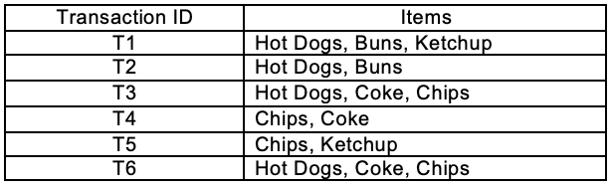
Consider below transactions . Find frequent itemsets .consider Minimum support count 2

Slide 29
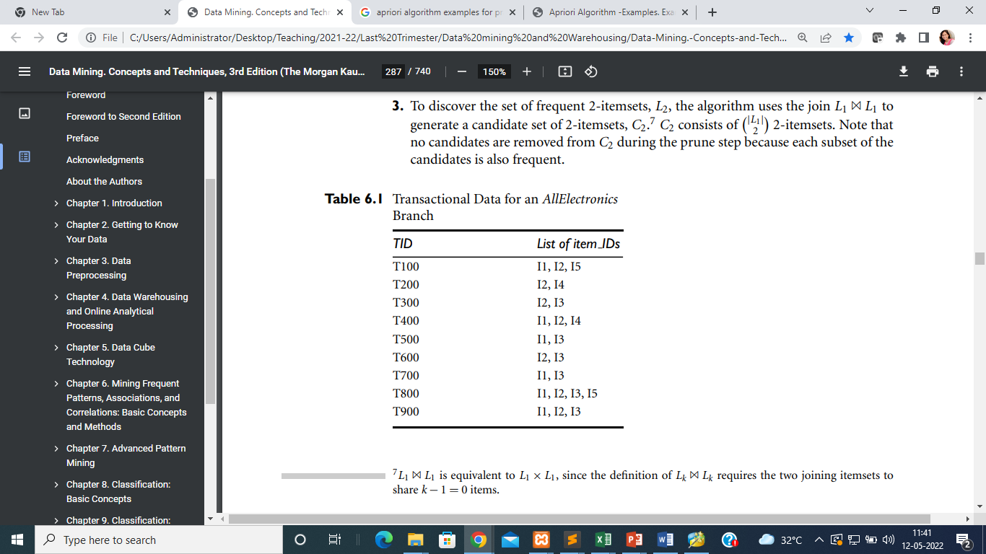
Consider below transactions . Find frequent itemsets .consider Minimum support count 2. Find Association rule with minimum support confidence 70%

Slide 30
Frequent pattern growth(fp-growth) algorithm
Frequent pattern Growth does not generate candidate sets.
After frequent 1-itemsets are generated
Transaction data is scanned and stored in a compact tree structure
Further database scans are avoided.

Slide 31
Construction of FP-Tree
The database is scanned once to find frequent 1-itemsets and their support counts
Sort frequent items in descending order of support counts to get a list of frequent items L
Create a root of an FP-tree as null
The database is scanned again. For each transaction in Database remove non-frequent items and sort items in Order of L. Let the sorted list be [p|P ] where p is the first element and P is the remaining list. If p is already present in the tree increment its node count else create a new node and link it to node links with same value. If P is nonempty insert P recursively

Slide 32
Consider below transactions and construct FP –Tree
Transaction ID | Items bought
T100 | { M, O, N, K, E, Y}
T200 | { D, O, N, K, E, Y}
T300 | { M, A, K, E}
T400 | { M, U, C, K, Y}
T500 | {C, O, O, K, I, E}
Let min_support = 60 % that is 3 transactions out of 5.

Slide 33
Step 1. The frequent one itemsets sorted in decreasing support count order
Step 2. The transactions are sorted in the same order
Item | Support Count
K | 5
E | 4
M | 3
Y | 3
O | 3
N | 2
C | 2
A | 1
I | 1
U | 1
D | 1
Transaction ID | Items bought in sorted order
T100 | { K, E, M, Y, O}
T200 | { K, E, Y, O}
T300 | { K, E, M}
T400 | { K, M, Y}
T500 | { K, E, O}
Transaction ID | Items bought
T100 | { M, O, N, K, E, Y}
T200 | { D, O, N, K, E, Y}
T300 | { M, A, K, E}
T400 | { M, U, C, K, Y}
T500 | {C, O, O, K, I, E}

Slide 34
FP Tree Generation
null
K:1
Transaction ID | Items bought in sorted order
T100 | { K, E, M, Y, O}
T200 | { K, E, Y, O}
T300 | { K, E, M}
T400 | { K, M, Y}
T500 | { K, E, O}
After Scanning of first transaction
E:1
M:1
Y:1
O:1

Slide 35
FP Tree Generation
null
Transaction ID | Items bought in sorted order
T100 | { K, E, M, Y, O}
T200 | { K, E, Y, O}
T300 | { K, E, M}
T400 | { K, M, Y}
T500 | { K, E, O}
K:2
After Scanning of Second transaction
E:2
M:1
Y:1
Y:1
O:1
O:1

Slide 36
FP Tree Generation
null
Transaction ID | Items bought in sorted order
T100 | { K, E, M, Y, O}
T200 | { K, E, Y, O}
T300 | { K, E, M}
T400 | { K, M, Y}
T500 | { K, E, O}
K:3
After Scanning of Third transaction
E:3
M:2
Y:1
Y:1
O:1
O:1

Slide 37
FP Tree Generation
null
Transaction ID | Items bought in sorted order
T100 | { K, E, M, Y, O}
T200 | { K, E, Y, O}
T300 | { K, E, M}
T400 | { K, M, Y}
T500 | { K, E, O}
K:4
After Scanning of Fourth transaction
M:1
E:3
Y:1
M:2
Y:1
Y:1
O:1
O:1

Slide 38
FP Tree Generation
null
Transaction ID | Items bought in sorted order
T100 | { K, E, M, Y, O}
T200 | { K, E, Y, O}
T300 | { K, E, M}
T400 | { K, M, Y}
T500 | { K, E, O}
K:5
After Scanning of Fifth transaction
M:1
E:4
Y:1
M:2
Y:1
O:1
Y:1
O:1
O:1

Slide 39
FP Tree
FP tree is a compact way of storing the transaction database.
Each similar combination of items is stored in FP-tree once as an overloaded path
Each node stores the count representing the number of occurrences of the path from root to the node.
Size of the FP-tree is much smaller than the transaction database.
The height of the FP-tree can be maximum one more than the number of frequent 1-itemsets.
Once the FP tree is constructed no more scans of the transaction database are required.

Slide 40
FP header table
A header table is associated with FP tree for efficient traversal.
It contains one entry for each item which is pointing to the first occurrence of the item
Subsequent occurrences of the item are linked.
null
K | 5
E | 4
M | 3
Y | 3
O | 3
K:5
M:1
E:4
Y:1
M:2
Y:1
O:1
Y:1
O:1
O:1

Slide 41
Consider below transactions . Construct FP Tree .consider Minimum support count 2

Slide 42
Consider below transactions . Construct FP (Assume Minimum support count 3

Slide 43
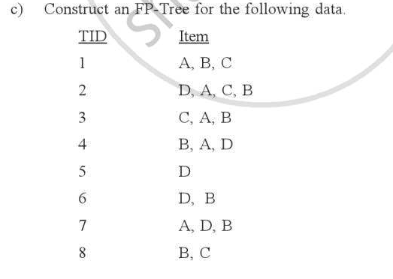

Slide 44
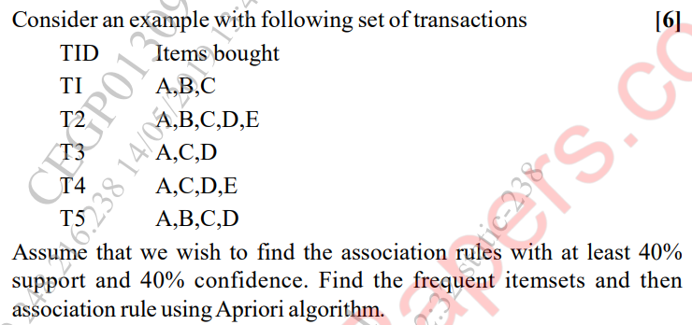

Slide 45
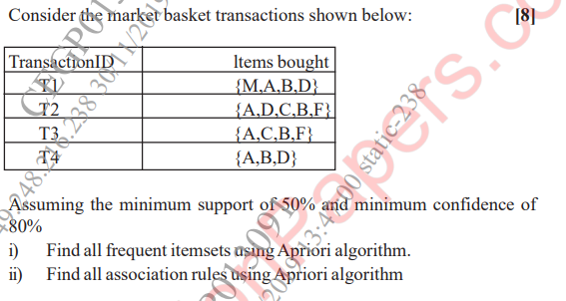

Slide 46
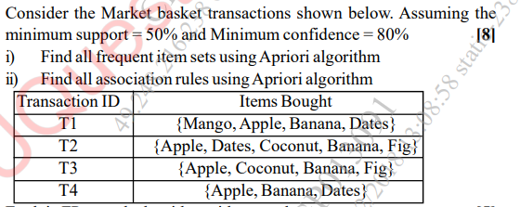

Slide 47
Revision
Find support count, support and confidence for the given itesmstes
State any four application of association rule mining
State and explain steps of Apriori Algorithm
Problem solving ( Generate frequent itemsets/Association rule using apriori algorithm for given database)
Problem soling (Construct FP-Tree for given database)

